Slide 1
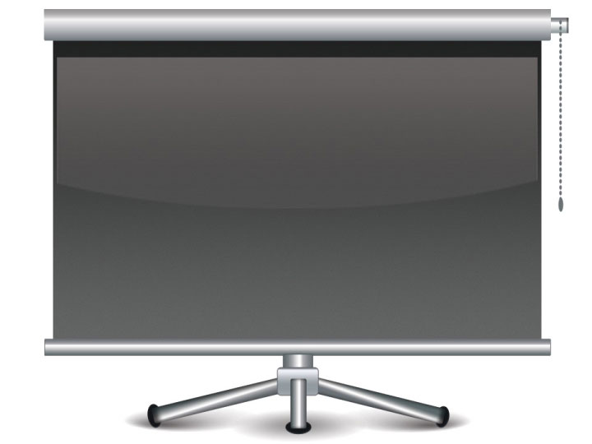
POWER TEMPLATE
Our company respects everybody is doing a best. Thinks the customer first of all. Will increase in the customer and thanks. Will become the company which endeavors always. company respects everybody is doing a best. Thinks the customer first of all. Loves the customer.

Slide 3
THANK YOU

